Slide 1
Stage 2a: Identifying the parts of the circulatory system and their functions

Slide 2
Learning objectives:
To identify and name the main parts of the human circulatory system
To describe the functions of the heart, blood vessels and blood

Slide 3
The circulatory system
The circulatory system is made up of the heart, blood and blood vessels.
It is responsible for carrying blood and dissolved substances to and from the entire body.
Notes:
More information: https://www.bbc.co.uk/bitesize/articles/zs8f8mn

Slide 4
The heart
The heart is a powerful muscle that pumps blood around the body.
A heart beats about 3 billion times during an average lifetime.

Slide 5
The heart
Inside, the heart has four chambers: two atria and two ventricles
Right Atrium
Left Atrium
Right Ventricle
Left Ventricle
Notes:
More information: https://www.bbc.co.uk/teach/class-clips-video/science-ks2-how-our-circulatory-system-keeps-us-alive/zhf76v4

Slide 6
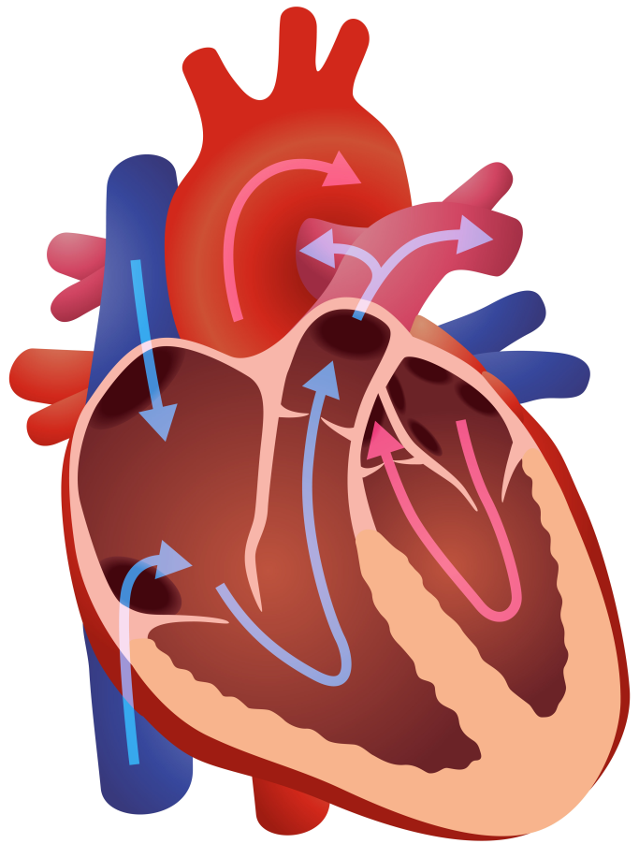
The heart
Mammals have a double circulatory system. This means our circulatory system has two circuits:
- One links the heart and lungs
- The other circuit links the heart with the rest of the body
The right side receives deoxygenated blood from the body and sends it to the lungs to collect more oxygen.
The left side receives oxygenated blood from the lungs and pumps it around the rest of the body.
Notes:
More information: https://www.bbc.co.uk/bitesize/articles/ztg6gdm

Slide 7
Blood Vessels
Blood travels around the body in blood vessels.
There are three types of blood vessels: arteries, veins and capillaries.
Notes:
More information: https://www.bbc.co.uk/bitesize/articles/zw8xb82

Slide 8
Arteries
Arteries carry oxygenated blood away from the heart and around the body.
They have thick, elastic walls so they can carry blood under pressure.
Think: why do you think they need this?

Slide 9
Veins
Arteries carry deoxygenated blood back to the heart.
They have valves to stop the blood from flowing in the wrong direct.
Think: why do you think they need this?

Slide 10
Capillaries
Capillaries are one cell thick. They link arteries and veins and exchange materials between blood and other body cells.
Capillaries

Slide 11
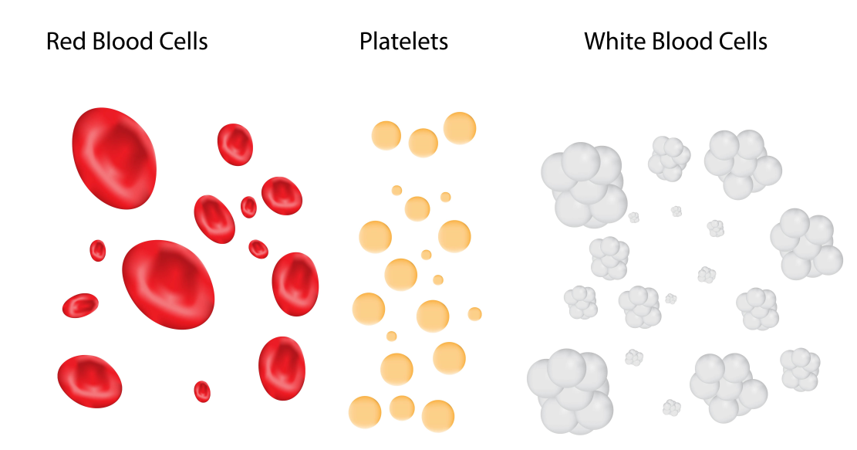
Blood
Blood carries substances around the body. It is made up of the following elements:
Red blood cells: transport oxygen
White blood cells: protect against disease
Platelets: repair cuts by causing blood to clot
Plasma: a liquid that transports nutrients, red and white blood cells and platelets
Notes:
More information: https://www.bbc.co.uk/bitesize/articles/zqv4cwx

Slide 12
Your tasks
1. Work in your business groups to research how to keep your heart healthy. Why is it important that we do this? Explain using your learning from this session. We will use this at later stages of the project.
2. Work in your business groups to use your learning from today to make a stop- motion animation to explain and demonstrate the journey that blood takes as it travels around the body.

Slide 13
Stage 2b: Investigating the effect of exercise on heart rate

Slide 14
Learning objective:
To investigate the effect of exercise on heart rate
Think:
Tell your partner 3 things you have learnt about the circulatory system.
How can we measure our heart beats?

Slide 15
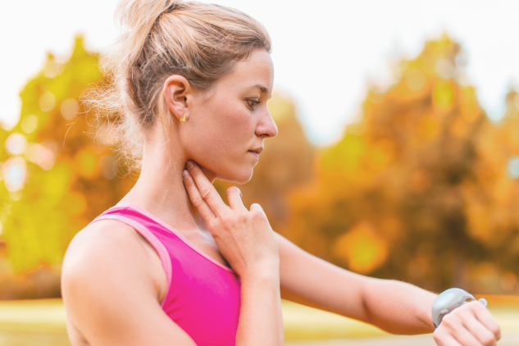
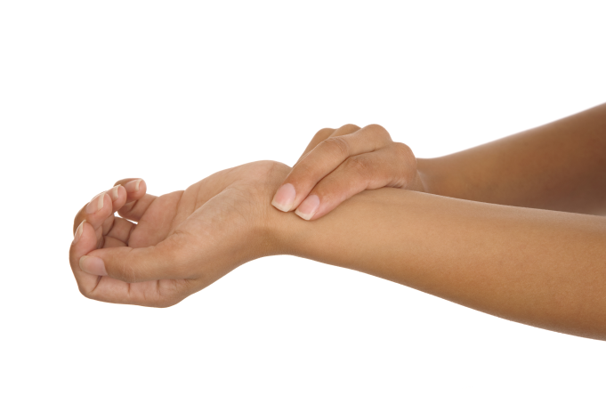
What is your pulse rate?
Your pulse is a measure of how fast your heart is beating. It is the number of beats your heart makes in one minute.
You can feel your pulse at certain points on your body. The easiest place to feel it is in your wrist, using the first two fingers of your other hand.

Slide 16
Let’s measure our resting pulse rate
Count how many beats you feel in 30 seconds.
We will double the result to calculate our number of beats per minute.

Slide 17
Finding the mean
What can you remember about finding a mean result? Why do we do this?
To find the mean, add up your 3 resting pulse measurements and divide the total by 3.

Slide 18
What happens to your heart rate when you exercise?
How could you use what we have learnt about the circulatory system to explain this?

Slide 19
Your task…
A recent report has claimed that giving children 2 minute breaks in the middle of lessons to take part in activities that increase their heart rate can improve both their general health and their concentration.
Scientists are interested in these claims but would like to find out which activity would be most effective at increasing children’s heart rate in 2 minutes.

Slide 20
Fair testing
A fair test is a controlled investigation that compares two things. In order for a test to be fair or well controlled, we have to make sure that only one thing (this is called a variable) is changed and everything else is kept the same.
A variable is anything that can affect the results we are observing or measuring.
In your investigation, you will test three forms of physical exercise.
By only changing one thing (the form of exercise) and keeping everything else the same, we can find out which exercise is the most effective at raising our heart rate.

Slide 21
Investigation planning
Think about variables that you will need to control (keep the same) for this investigation.
How will you measure which form of exercise is the most effective at raising your heart rate?
Write up your investigation plan and explain why you are changing your variables or keeping them constant.

Slide 22
Line graphs
Line graphs are used to show how a variable changes over time.
Straight lines join a series of points together.
The horizontal axis is called the x axis; this shows regular intervals of time.
The vertical axis is called the y axis; this shows the variable we are measuring over time (in this case, your heart rate).

Slide 23
Drawing a line graph
Draw your graph on squared or graph paper
When deciding on a scale for your y axis, look at the data you have collected to see how large your range is.
Your scale should go up in regular intervals: twos, fives or tens usually work well.
Remember to start your y axis at zero.
Your x axis will show minutes after exercise.
Remember to leave an equal number of squares between each number on your x axis.
Mark your pulse rate at each time point on the graph with a cross and then join all your crosses together with a ruler.

Slide 24
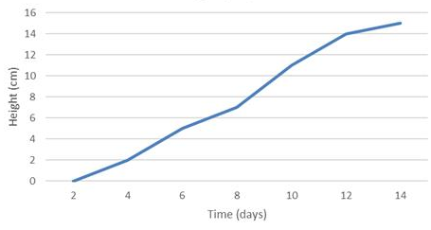
Drawing a line graph
The scale increases in regular intervals
Remember to give your graph a suitable title
x
x
The scale starts at zero
x
Y axis
x
x
x
x
Time is always shown on the x axis
Points are joined with straight, ruled lines.
X axis

Slide 25
Evaluation
Write a paragraph to explain what your results showed. Think critically about how you conducted your investigation: Was it well controlled? Could you have improved your design or fair testing? How might this have impacted your results?

